Slide 1


Major/Minor Project
A Deep Learning Approach for Ship Detection & Localization using Satellite Imagery
Presented by:
R2142201168 - Sparsh Patial
R214220127 - Alakh Niranjan
R214220116 - Akshat Mittal
R214220082 - Aditya Aryan
Mentored By:
Dr. Tanupriya Choudhury
Cluster:
Informatics Cluster

Slide 2
Content
Introduction
Literature Review
Objectives
Methodology
Working Model
Results
Conclusion
References
2

Slide 3
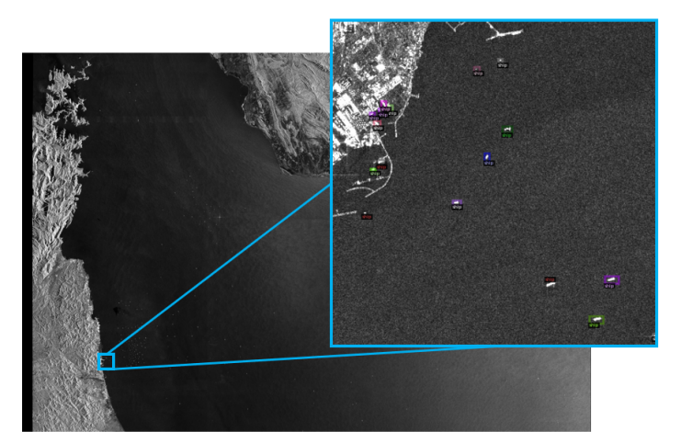
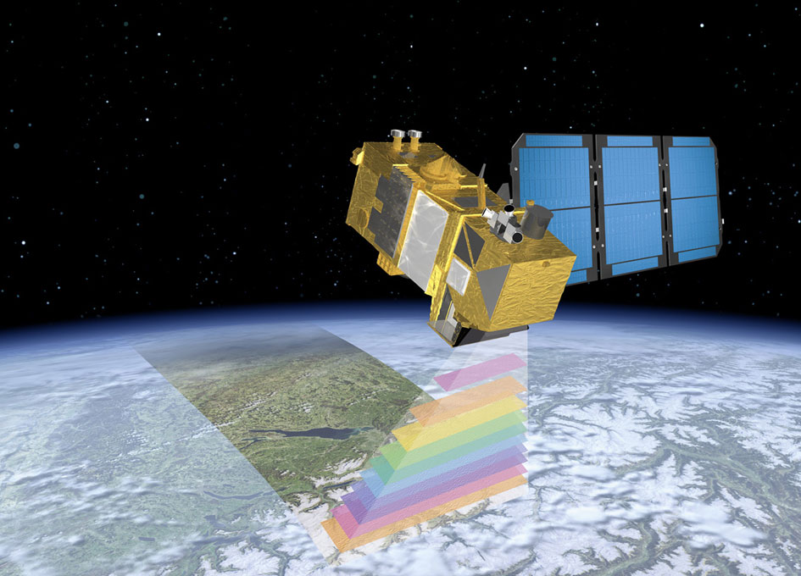
Introduction
Satellite technology is now crucial for tracking marine vessels due to the rising maritime traffic, making accurate ship detection essential for industries such as maritime security, trade, and transportation.
This presentation will examine how satellite images revolutionized ocean monitoring through ship detection. We'll cover detection methods, techniques, and challenges involved.
It includes ship detection's various applications such as detecting illegal fishing and preventing piracy, as well as its potential contribution to a safer and sustainable ocean environment.
Explore the challenges associated with ship detection using satellite images, such as weather conditions, image resolution, and target size, and how these challenges can impact the accuracy of ship detection.
Fig No.1: Satellite Image
Fig No.2: Sentinel-2 Satellite
3

Slide 4

Introduction
Technical Concepts used
Python libraries used
Tensorflow is open source platform for machine learning. It has a comprehensive, flexible ecosystem of tools, libraries, and community resources that lets researchers push the state-of-the-art in ML and developers easily build and deploy ML-powered applications.
Matplotlib is a comprehensive library for creating static, animated, and interactive visualizations in Python.
Create publication quality plots.
Make interactive figures that can zoom, pan, update.
Keras is an open-source software library that provides a Python interface for neural networks. Keras acts as an interface for the TensorFlow library.
Numpy- NumPy offers comprehensive mathematical functions, random number generators, linear algebra routines, Fourier transforms, and more.
Fig No.3: Different Libraries
4

Slide 5



Introduction
Technical Concepts used
U-NET Model : Deep Convolutional Neural Network.
SAR(Synthetic Aperture Radar): Sensor that first transmits microwave signals and then receives back the signals that are returned, or backscattered , from the Earth's surface to create two-dimensional images or three-dimensional reconstructions of objects, such as landscapes
Arc Map Software: ArcMap is where you display and explore GIS datasets for your study area, where you assign symbols, and where you create map layouts for printing or publication. ArcMap is also the application you use to create and edit datasets.
SNAP (Sentinel Application Platform): ESA SNAP is a free and open toolbox for processing data products from numerous satellite missions such as the EU’s Copernicus Sentinel-1, Sentinel-2 and Sentinel-3, as well as ESA’s SMOS mission, and ‘Third Party Missions’.
Fig No.4: Software use to process the Sar dataset
5

Slide 6
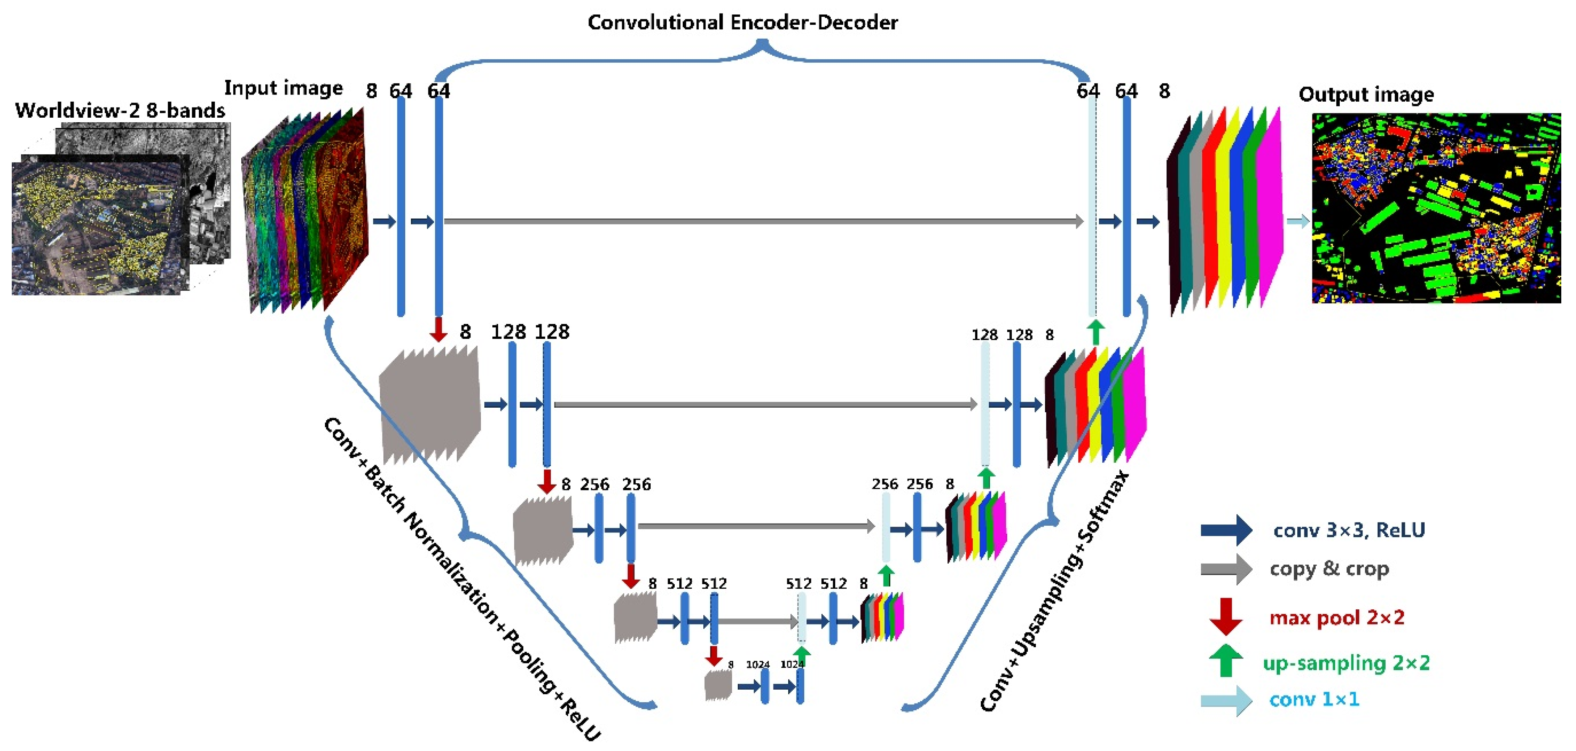
Introduction
Technical Algorithms used
U-NET Model
U-Net is a popular convolutional neural network used for ship detection in satellite images. It's trained on annotated images where ships are labeled as foreground and background as the sea/sky.
After learning to recognize ship features, U-Net segments new images by producing a map of probabilities for each pixel belonging to foreground/background.
This map is thresholded to obtain a binary mask where foreground pixels represent ships and background pixels represent the sea/sky.
Fig No.5: U-NET Architecture
6

Slide 7
Introduction
Technical Algorithms used
The U-Net model is a popular neural network architecture for semantic segmentation tasks, including ship detection. Here's a general overview of how the U-Net algorithm works for ship detection:
Input: The U-Net model takes as input an image that contains one or more ships.
Encoding Path: The image is first passed through a series of convolutional layers that extract features from the image. The size of the feature maps is reduced at each layer, while the number of feature maps is increased.
Decoding Path: The feature maps obtained from the encoding path are then passed through a series of transposed convolutional layers that upsample the feature maps back to the size of the input image. At each layer, the feature maps are concatenated with the corresponding feature maps from the encoding path, allowing the decoder to combine information from different scales.
7

Slide 8
Introduction
Technical Algorithms used
Output: The final layer of the U-Net model produces a segmentation mask that indicates which pixels in the input image belong to a ship and which do not. The output mask has the same size as the input image.
Training: The U-Net model is trained using a loss function that measures the difference between the predicted segmentation mask and the ground truth mask. The most common loss function used for semantic segmentation is the cross-entropy loss.
By training the U-Net model on a large dataset of ship images with their corresponding ground truth masks, the model can learn to accurately detect ships in new images.
8

Slide 9
Introduction
Motivation
The motivation for the topic "A Deep Learning Approach for Ship Detection and Localization using Satellite Imagery" depicts the need for accurate and efficient methods for monitoring maritime activity. With the increasing demand for global trade and the importance of marine transport, it is crucial to have reliable methods for detecting and tracking ships in the open sea.
Satellite imagery offers a powerful tool for monitoring marine transport activity over large areas, but manually analyzing such imagery is time-consuming and error-prone.
Deep learning, with its ability to learn complex features and patterns from large amounts of data, has shown great promise in various computer vision tasks, including object detection.
Applying deep learning techniques to ship detection and localization using satellite imagery could potentially lead to more accurate and efficient methods for monitoring maritime activity.
9

Slide 10
Introduction
Problem Statement
WHAT:
The problem statement for the topic "A Deep Learning Approach for Ship Detection & Localization using Satellite Imagery" is to develop an accurate and efficient system for detecting and localizing ships in satellite images.
WHY:
The objective is to use deep learning techniques to extract relevant features from the images and classify them as either containing a ship or not, and to determine the precise location of the ship within the image.
IMPACT:
This technology can be used for various applications such as maritime surveillance, monitoring of fishing activities, and detecting illegal activities in marine protected areas. The challenge is to develop a robust and scalable system that can handle large datasets and perform accurately in different environmental conditions, such as varying weather and lighting conditions and different ship sizes with respect to the area that is being selected for the model evaluation or analysis.
10

Slide 11
Introduction
Area of application
Nowadays, remote sensing plays a vital role in the automatic detection of ship objects in the sea surface area that exhibit the capability of locating positions of ships from remote sensing images holding the wide range of applications like:
Traffic surveillance.
Illegal fishing surveillance.
Smuggling activities monitoring.
Sea pollution monitoring.
Naval warfare.
Ship rescue.
Oil discharge control etc.
11

Slide 12
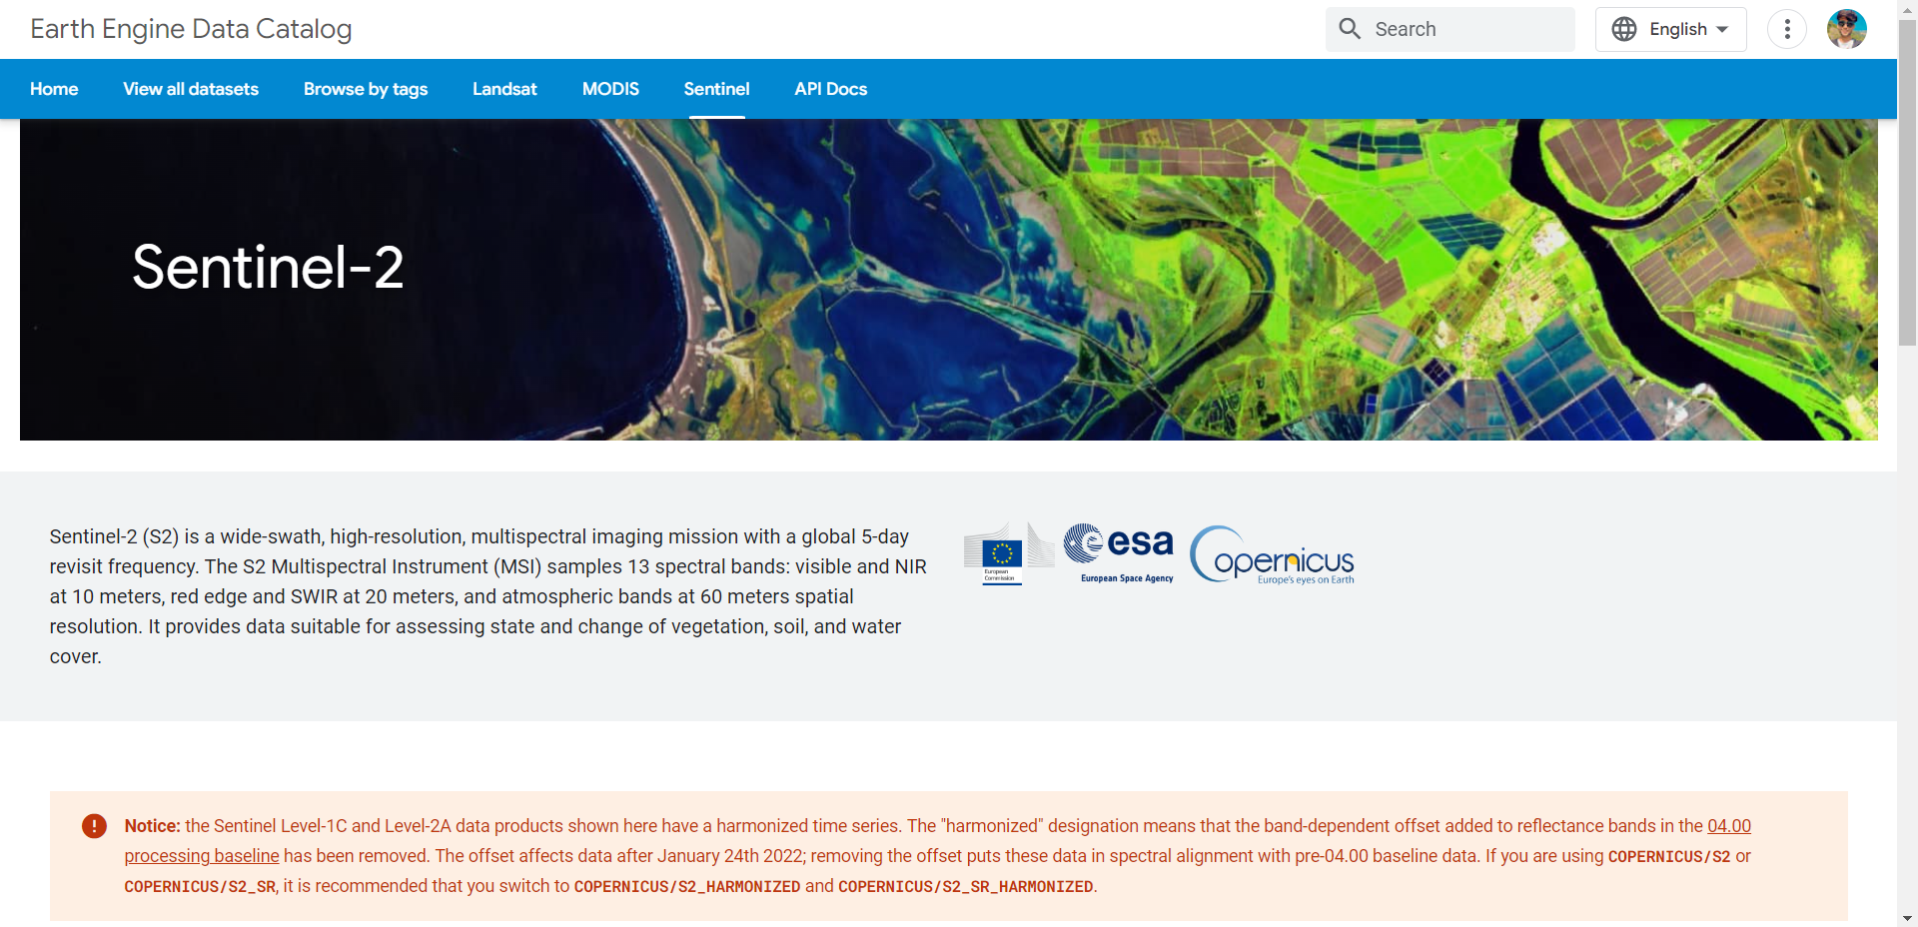
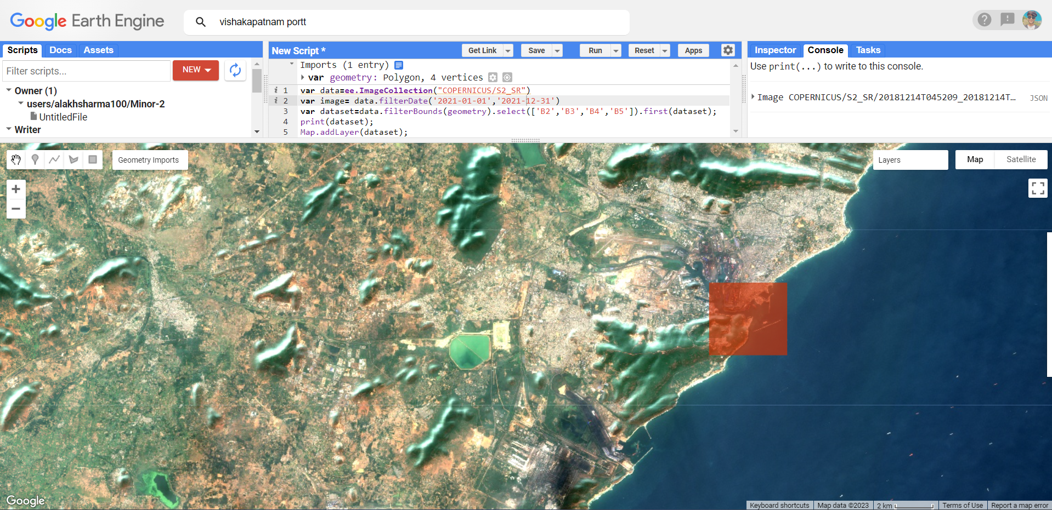
Introduction
Dataset and input format
12

Slide 13
Introduction
Dataset and input format
13

Slide 14
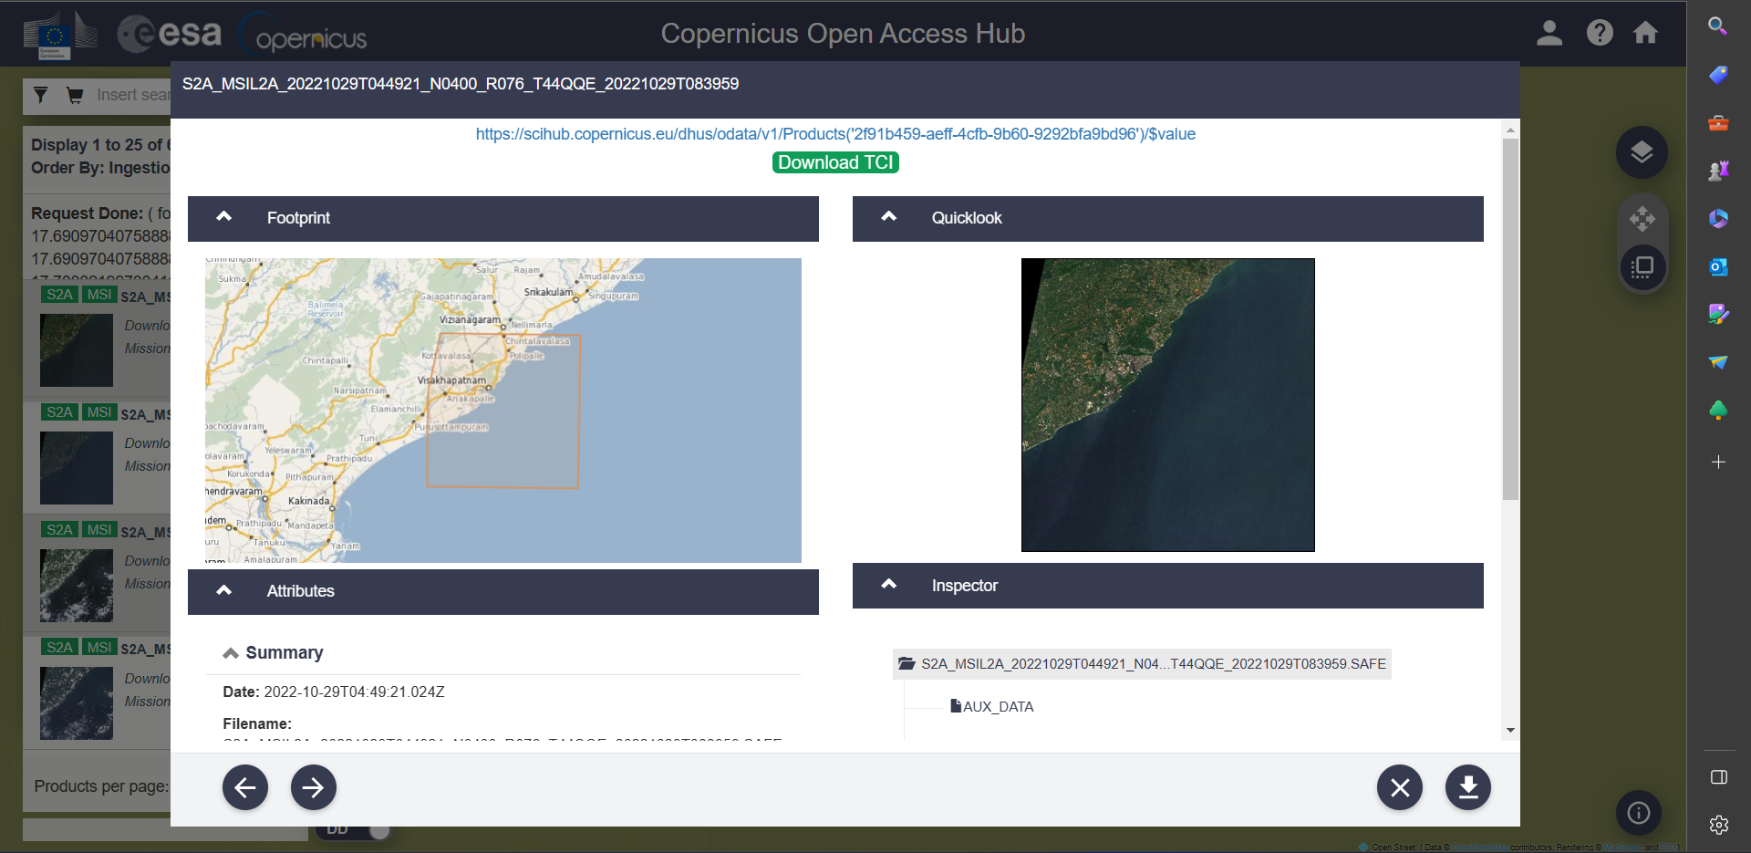
Introduction
Dataset and input format
14

Slide 15
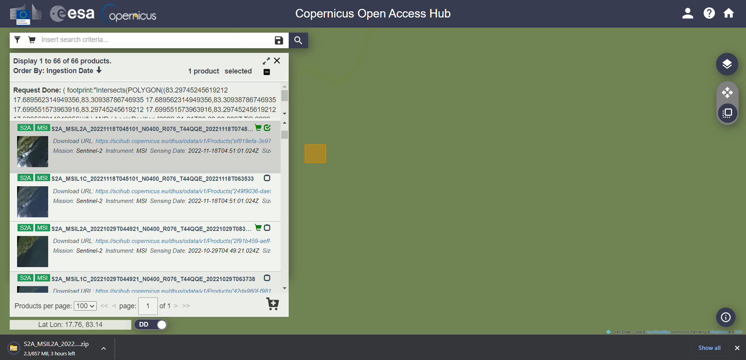
Introduction
Dataset and input format
15

Slide 16
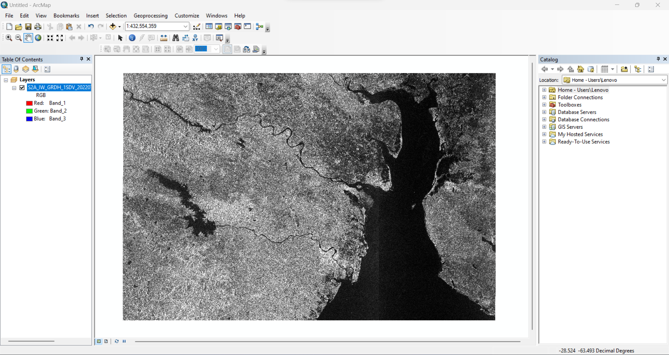
Introduction
Dataset and input format
16

Slide 17
Introduction
Dataset and input format
Our project uses two sites for data collection -Copernicus open access hub and Google earth engine
COAH is an official European site used to generate datasets only for official work which concludes only industries and student projects as making an account in this site is a very hard task as it gives the official link after verifying the email id of the respective industries or the university’s official mail id.
These sites are handy as its provides all the necessary information to the user like the colour of the image or the size of the pixel.
Our project uses Sentinel 2 satellite images
The ArcMap software is used to convert the image from RAW format to PNG format, and it also provides the vegetation to the image and its also adds bands to the image to make the image more clear to the user.
Total number of images used in our project is 192556 in our training directory.
Shape of the images are (768,768,3)
17

Slide 18
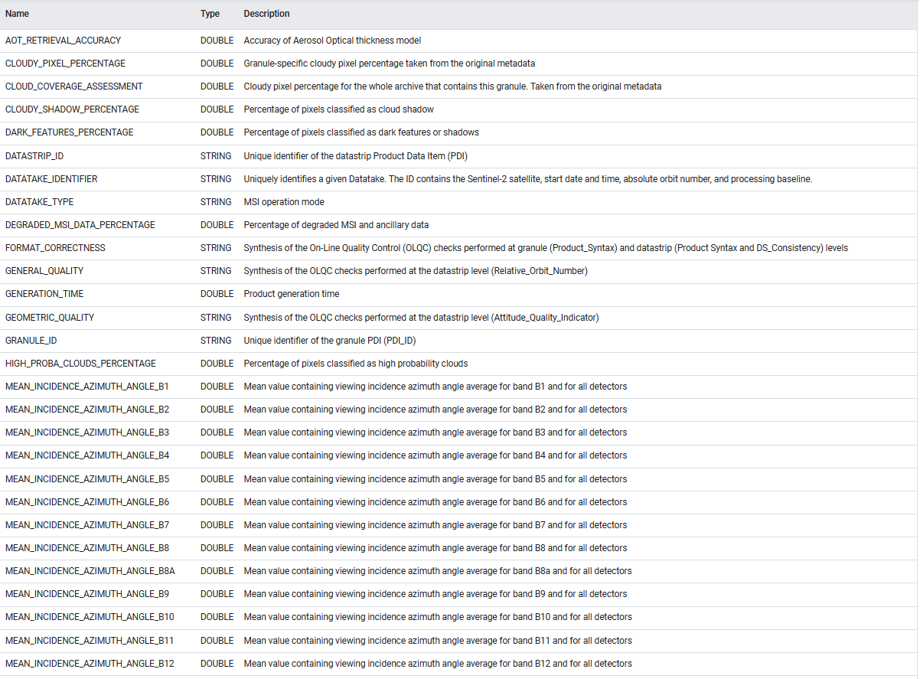
Introduction
Dataset and input format
18

Slide 19
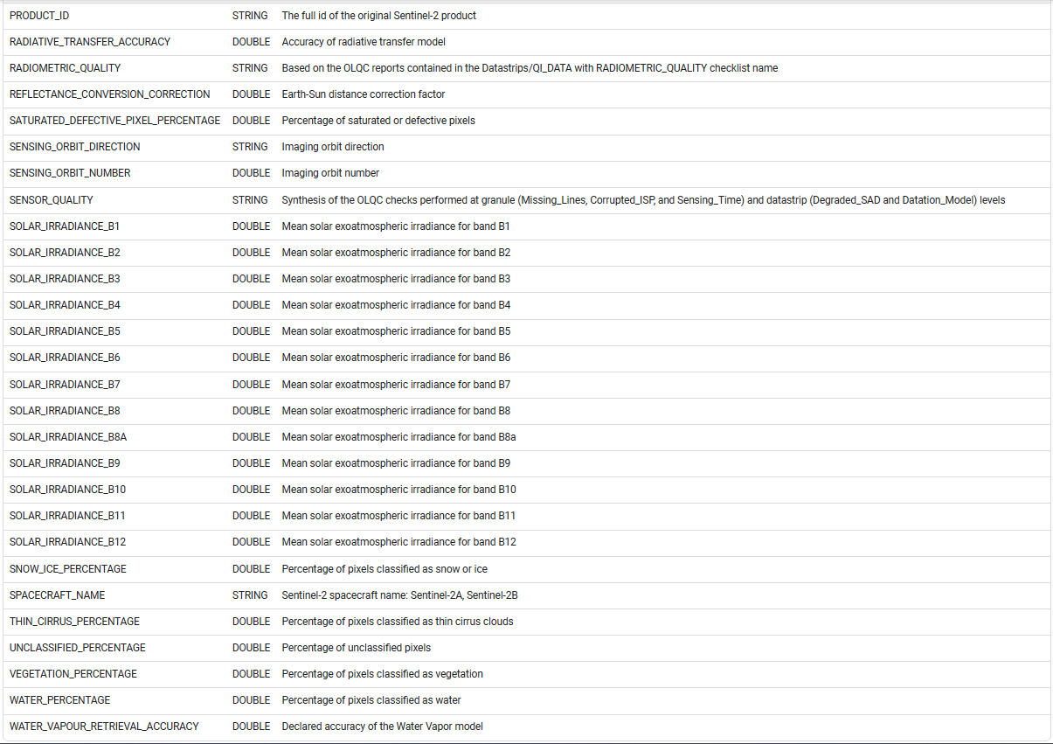
Introduction
Dataset and input format
19

Slide 20
Literature Review
[1] Chong, J.; Zhu, M. Survey of the Study on Ship and Wake Detection in SAR Imagery. Acta Electron. Sin. 2003, 31, 1356–1360.
In recent years, researches of ship detection using synthetic aperture radar (SAR) images have received considerable attentions in the area of marine remote sensing . The origin and development of ship detection in SAR imagery is reviewed.The physical factors that would affect ship and wake are analyzed.
[2] Xi, Y.; Zhang, X.; Lai, Q.; Li, W.; Lang, H. A New PolSAR Ship Detection Metric Fused by Polarimetric Similarity and the Third Eigenvalue of the Coherency Matrix. In Proceedings of the IEEE International Geoscience and Remote Sensing Symposium, Beijing, China, 10–15 July 2016; pp. 112–115
SAR image used for ship detection, the sea surface echo is weak and changes randomly, which means that the sea surface has an approximate low-rank attribute. The ship echo is strong and the ship is sparsely distributed on the sea surface, which means that the ship has an approximate sparse attribute.
[3] Yu, W.; Wang, Y.; Liu, H.; He, J. Superpixel-Based CFAR Target Detection for High-Resolution SAR Images. IEEE Geosci. Remote Sens. Lett. 2016, 13, 730–734.
In dealing with the problem of target detection in high-resolution Synthetic Aperture Radar (SAR) images, segmenting before detecting is the most commonly used approach. After the image is segmented by the superpixel method, the segmented area is usually a mixture of target and background, but the existing regional feature model does not take this into account, and cannot accurately reflect the features of the SAR image.
19

Slide 21
Literature Review
[4] Fan, Q.; Chen, F.; Cheng, M.; Wang, C.; Li, J. A Modified Framework for Ship Detection from Compact Polarization SAR Image. In Proceedings of the IEEE International Geoscience and Remote Sensing Symposium, Valencia, Spain, 22–27 July 2018; pp. 3539–3542.
Although AIS information was used to verify the labeled dataset over several sub-areas, it is unfortunate that not all labeled ships in this study were supported by AIS data. It is a fact that not all ships on the ocean carry AIS transponders,likewise, especially for archived earth observations.
[5] Markopoulos, P.; Dhanaraj, M.; Savakis, A. Adaptive L1-Norm Principal-Component Analysis with Online Outlier Rejection. IEEE J. Sel. Top. Signal Process. 2018, 12, 1131–1143.
Both these extreme approaches exhibit an unfavorable performance/cost trade-off. In contrast, a preferred method would leverage each new measurement, together with previous ones, to efficiently update the existing bases. The development of such a method is the main contribution of this paper,
[6] Javed, S.; Mahmood, A.; Al-Maadeed, S.; Bouwmans, T.; Ki Jung, S. Moving Object Detection in Complex Scene Using Spatiotemporal Structured-Sparse RPCA. IEEE Trans. Image Process. 2018, 28, 1007–1022.
To address this issue, we propose a spatiotemporal structured sparse RPCA algorithm for moving objects detection, where we impose spatial and temporal regularization on the sparse component in the form of graph Laplacians. Each Laplacian corresponds to a multi-feature graph constructed over superpixels in the input matrix
20

Slide 22
Literature Review
[7] Biondi, F. Low-Rank Plus Sparse Decomposition and Localized Radon Transform for Ship-Wake Detection in Synthetic Aperture Radar Images. IEEE Geosci. Remote Sens. Lett. 2018, 15, 117–121.
The problem in obtaining stable motion estimation of maritime targets is that sea clutter makes wake
Structure detection and reconnaissance are difﬁcult. This research presents a complete procedure for automatic estimation of maritime target motion parameters by evaluating the generated Kelvin waves detected in synthetic aperture radar (SAR) images.
[8] Li, C.; Yu, Z.; Chen, J. Overview of Techniques for Improving High-resolution Spaceborne SAR Imaging and Image Quality. J. Radars 2019, 8, 717–731.
The start-stop hypothesis considers that the radar does not move in the time between sending and receiving the signal of spaceborne SAR, but this assumption is not accurate. For this purpose, the literature established a two-way slant range model and proposed a strict single-base configuration with an equivalent center time, but it still did not have an explicit expression, which was not conducive to the research of specific imaging methods.
[9] Liu, T.; Yang, Z.; Yang, J.; Gao, G. CFAR Ship Detection Methods Using Compact Polarimetric SAR in a K-Wishart Distribution. IEEE J. Sel. Top. Appl. Earth Obs. Remote Sens. 2019, 12, 3737–3745.
Synthetic aperture radar (SAR) is a microwave imaging sensor capable of all-day, all-weather observations of the ground. Therefore, SAR is widely used in disaster investigation, environmental monitoring, target detection and other fields. At present, SAR ship detection has important research value in both the military field
21

Slide 23
Literature Review
[10] Li, J.; Tian, J.; Gao, P.; Li, L. Ship Detection and Fine-Grained Recognition in Large-Format Remote Sensing Images Based on Convolutional Neural Network. In Proceedings of the IEEE International Symposium on Geoscience and Remote Sensing (IGARSS), Waikoloa, HI, USA, 26 September–2 October 2020; pp. 2859–2862.
Ship detection and fine-grained recognition in large-format remote sensing image are an important research direction in the field of remote sensing image detection. But less research has been done in this area. Aiming at this problem, this paper constructs a large-format remote sensing image ship target dataset with ship category information, and proposes a background filtering network and a ship fine-grained classification network.
[11] Ai, J.; Cao, Z.; Xing, M. An Adaptive-trimming-depth Based CFAR Detector of Heterogeneous Environment in SAR Imagery. Remote Sens. Lett. 2020, 11, 730–738.
Traditional CFAR detectors generally use all samples in the background window for parameter estimation. However, in the heterogeneous regions, these detectors will overestimate the parameters used for statistical modelling due to the interference of high-intensity interference pixels such as adjacent ships, ghosts, breakwaters and azimuth ambiguity
[12] Ai, J.; Cao, Z.; Mao, Y.; Wang, H.; Wang, F.; Jin, J. An Improved Bilateral CFAR Ship Detection Algorithm for SAR Image in Complex Environment. J. Radars 2021, 10, 499–515.
The intensity level division based on the nonuniform quantization method can improve the similarity and contrast information of weak targets, leading to improved ship detection rate. The information fusion of strength spatial domain is to fuse the spatial similarity, distance direction and strength information, which can further improve the detection rate and describe the ship structure information.
22

Slide 24
Literature Review
[13] Liu, T.; Yang, Z.; Jiang, Y.; Gao, G. Review of Ship Detection in Polarimetric Synthetic Aperture Imagery. J. Radars 2021, 10, 1–19.
Various sensing and imaging techniques are developed to record different information from four primary physical quantities related to the optical field: intensity, wavelength, phase, and polarization. For example, traditional monochromatic sensors measure intensity information of optical radiation in a single wavelength. Spectral sensors, such as color cameras and multispectral devices, measure intensity information in multiple wavelengths simultaneously
[14] Zou, B.; Qiu, Y.; Zhang, L. Ship Detection Using PolSAR Images Based on Simulated Annealing by Fuzzy Matching. IEEE Geosci. Remote Sens. Lett. 2022, 19, 1–5.
The detection statistics are binarized according to the local threshold set by the detection statistic value of the keypoint to complete the ship detection. Experiments on three data sets obtained from the RADARSAT-2 and AIRSAR quad-polarization data demonstrate that the proposed detector is effective for ship detection.
23

Slide 25
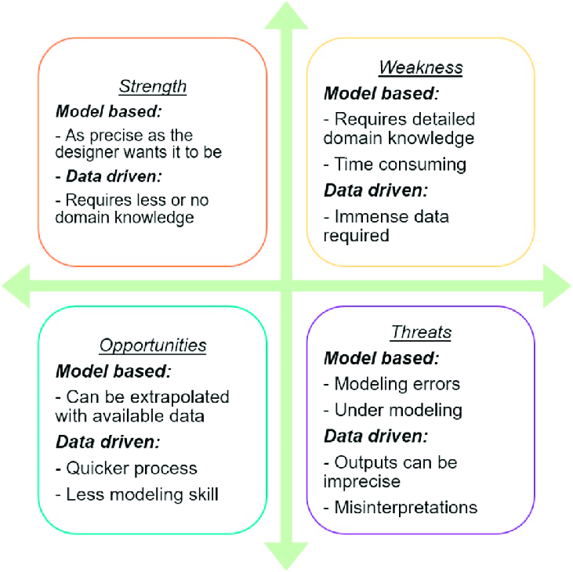
Literature Review
SWOT Analysis
STRENGTH:
The model will have an ability to learn and analyze the images accurately.
WEAKNESS:
It works as a black box and takes time in computations.
The complexities that are taking place in hidden layers remains unknown to us.
OPPORTUNITIES:
The model can be used to solve real world problems accurately.
THREAT:
If the system corrupts it can affect our cache memory.
it can drastically affect our GPU and CPU.
Fig No.6: SWOT Analysis
24

Slide 26
Objective
Main Objective
To design and develop a deep learning model that can accurately detect and localize ships in satellite imagery.
To collect and preprocess a large dataset of satellite imagery with labeled ship locations, to be used for training and testing the deep learning model.
To investigate and compare different deep learning architectures and techniques, such as convolutional neural networks (CNNs), recurrent neural networks (RNNs), and transfer learning, to identify the most effective approach for ship detection and localization.
To evaluate the performance of the deep learning model on a variety of real-world satellite imagery datasets, including images taken in different weather and lighting conditions, and from different satellite platforms.
25

Slide 27
Objective
Main Objective
To explore the potential applications of ship detection and localization using satellite imagery, such as in maritime surveillance, environmental monitoring, and commercial shipping operations.
To identify and address any ethical or privacy concerns related to the use of satellite imagery for ship detection and localization, such as the risk of surveillance or violation of international law.
To publish the research findings in relevant academic journals or conferences, and to share the code and data publicly to facilitate further research in this area.
26

Slide 28
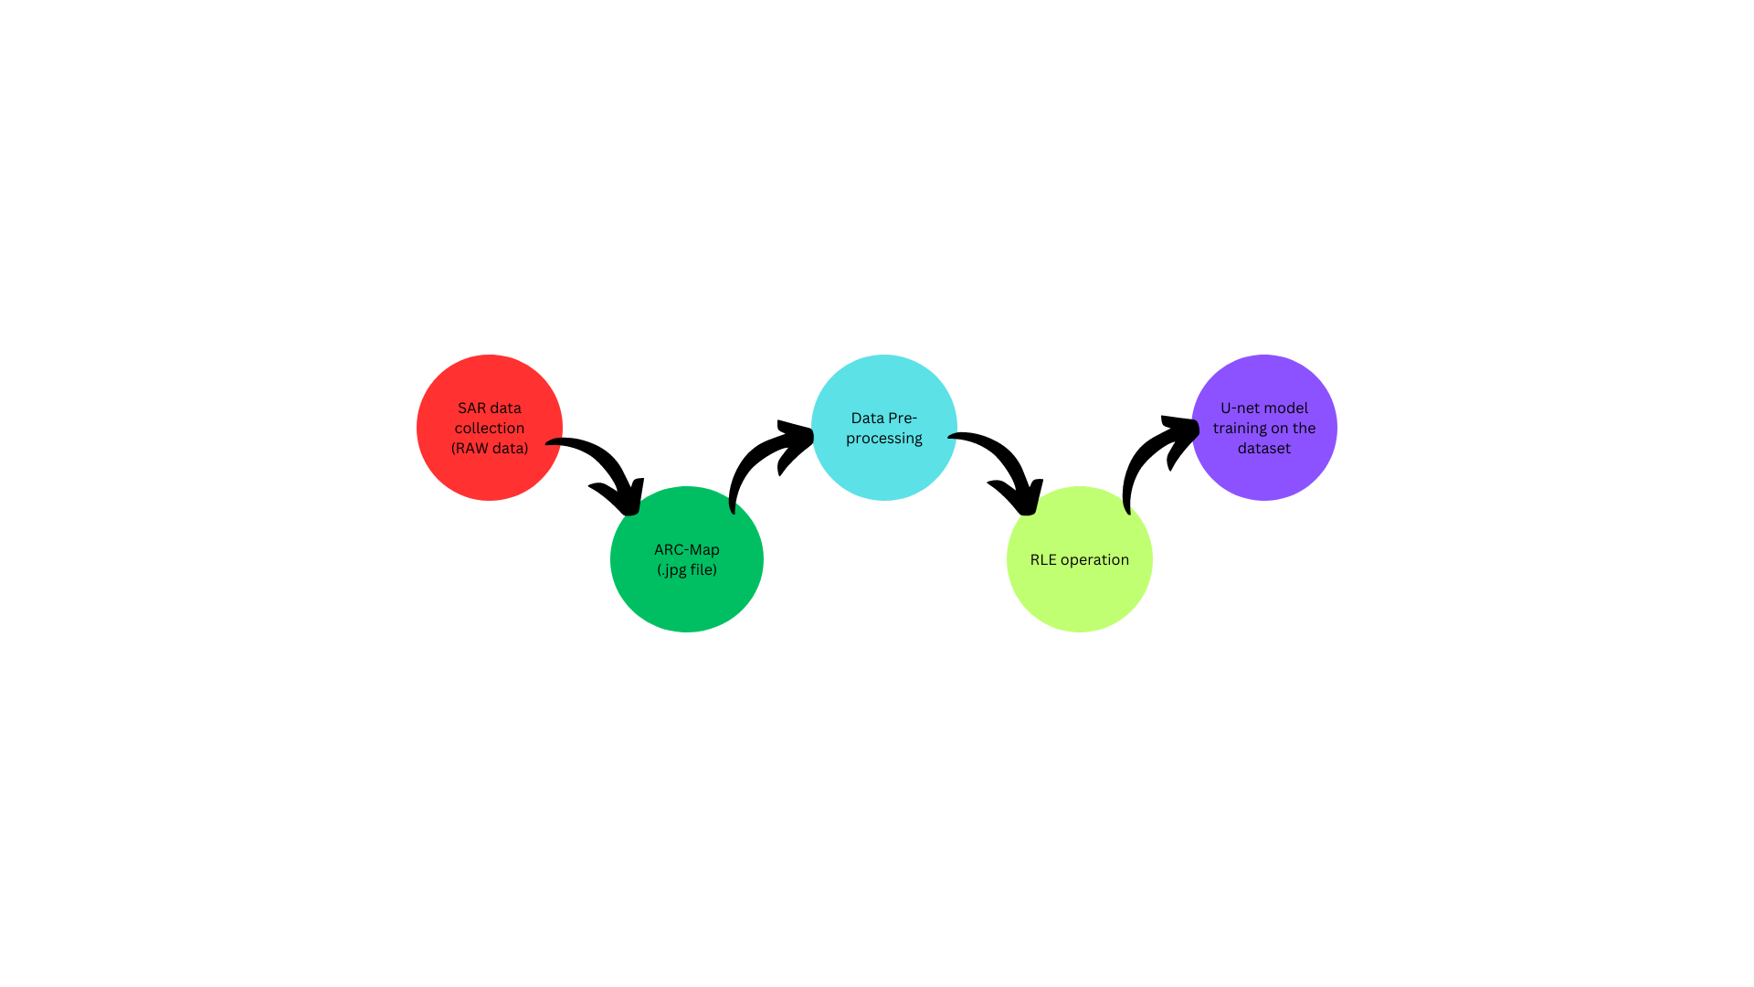
Methodology
Reference Software Model
Fig No.7: Reference Software Model
27

Slide 29
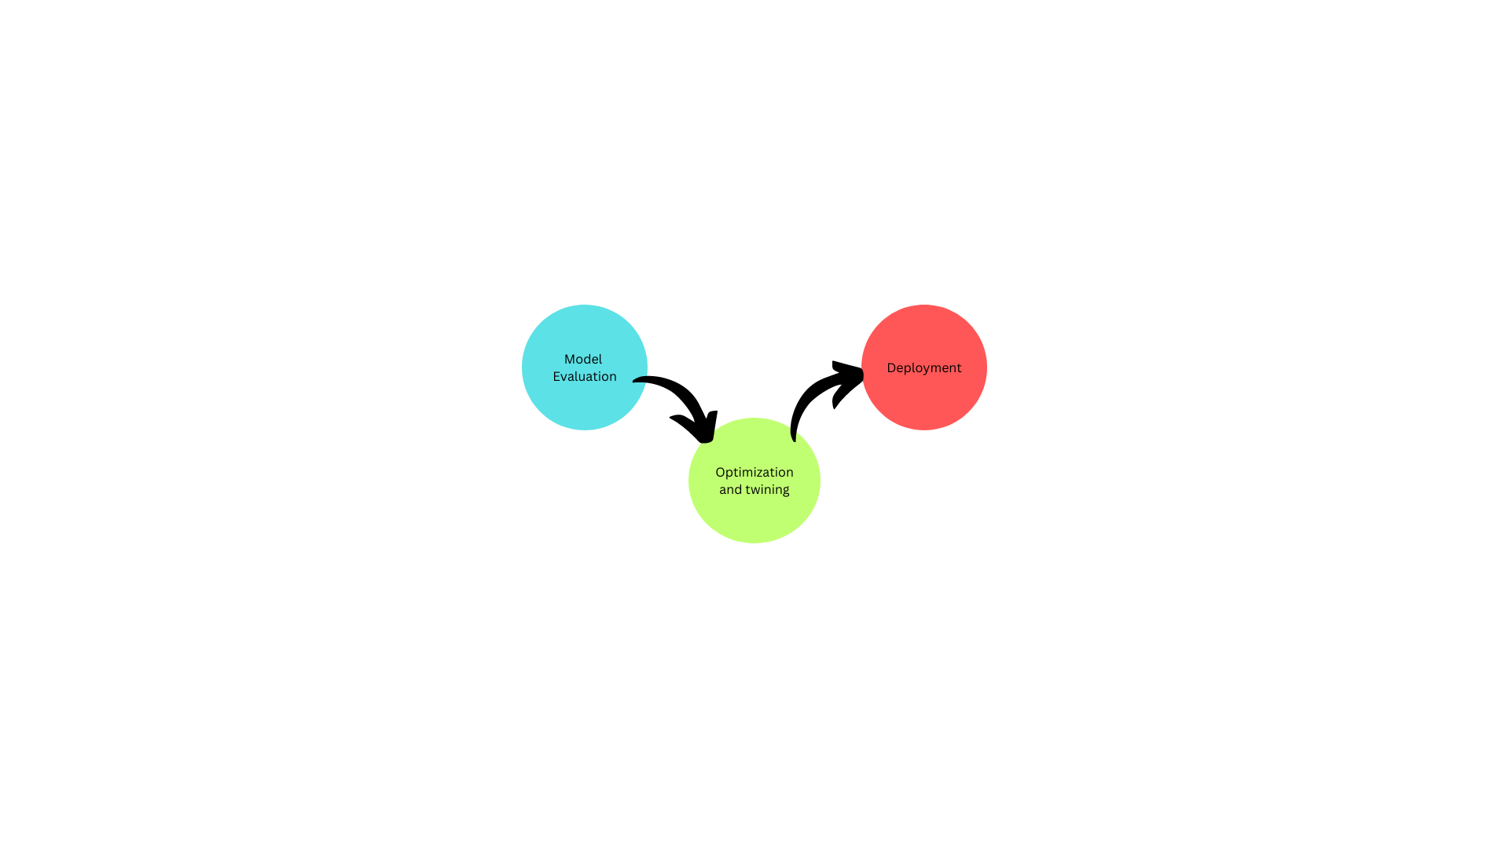
Methodology
Reference Software Model
Fig No.8: Reference Software Model
28

Slide 30
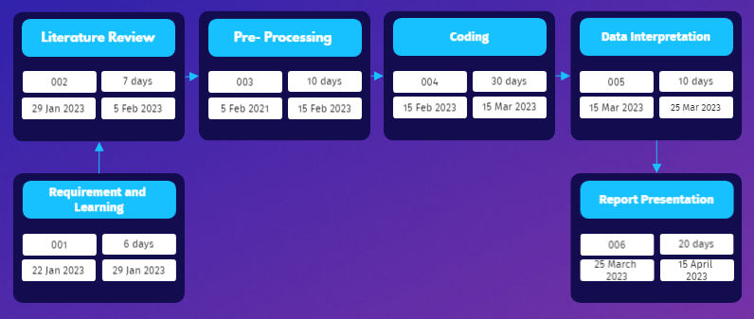
Methodology
Timeline
Fig No.9: Pert chart
29

Slide 31
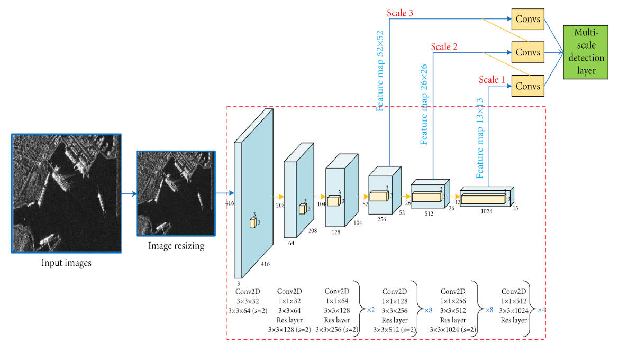
Working Model
Requirement analysis (Link of SRS):SRS
Fig No.10: Working of U-NET
30

Slide 32
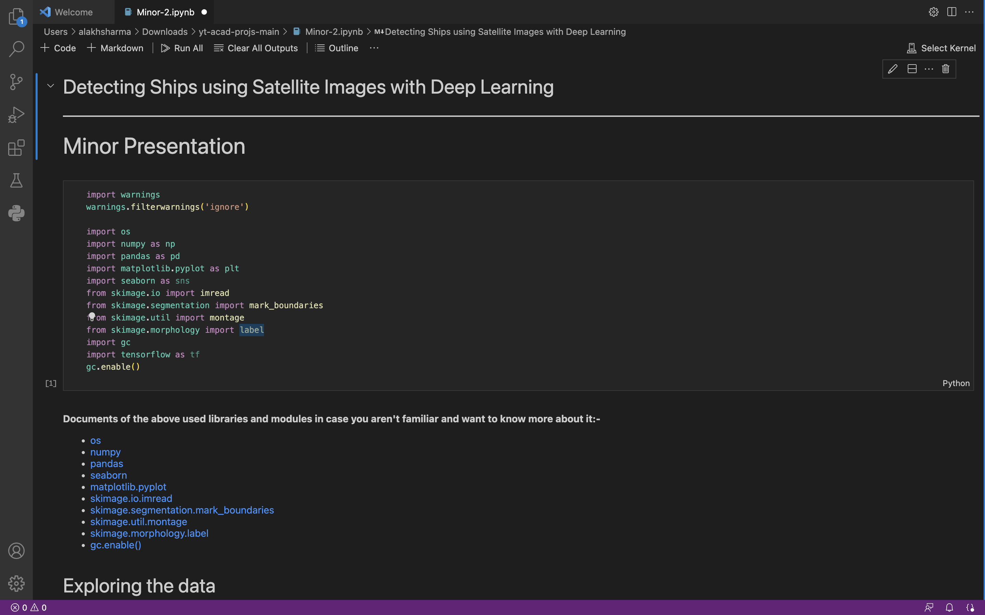
Working Model
Working Module
31

Slide 33
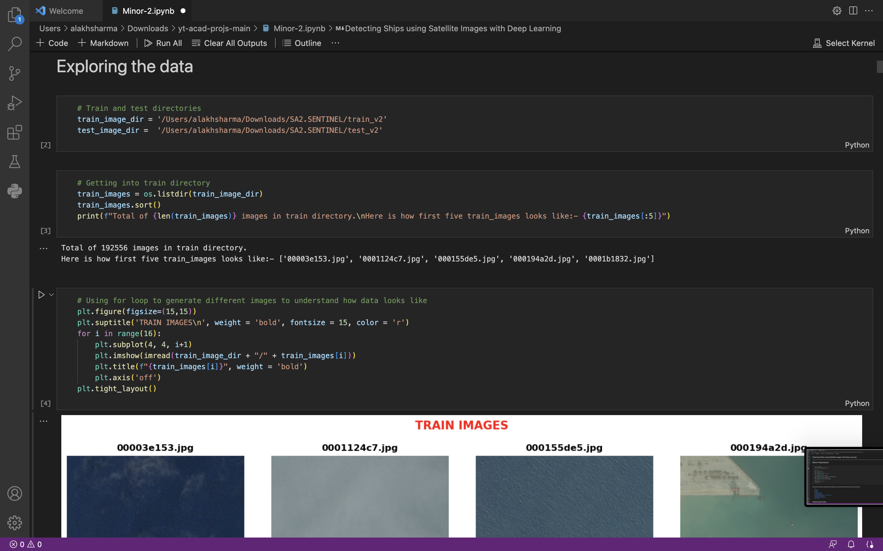
Working Model
Working Module
32

Slide 34
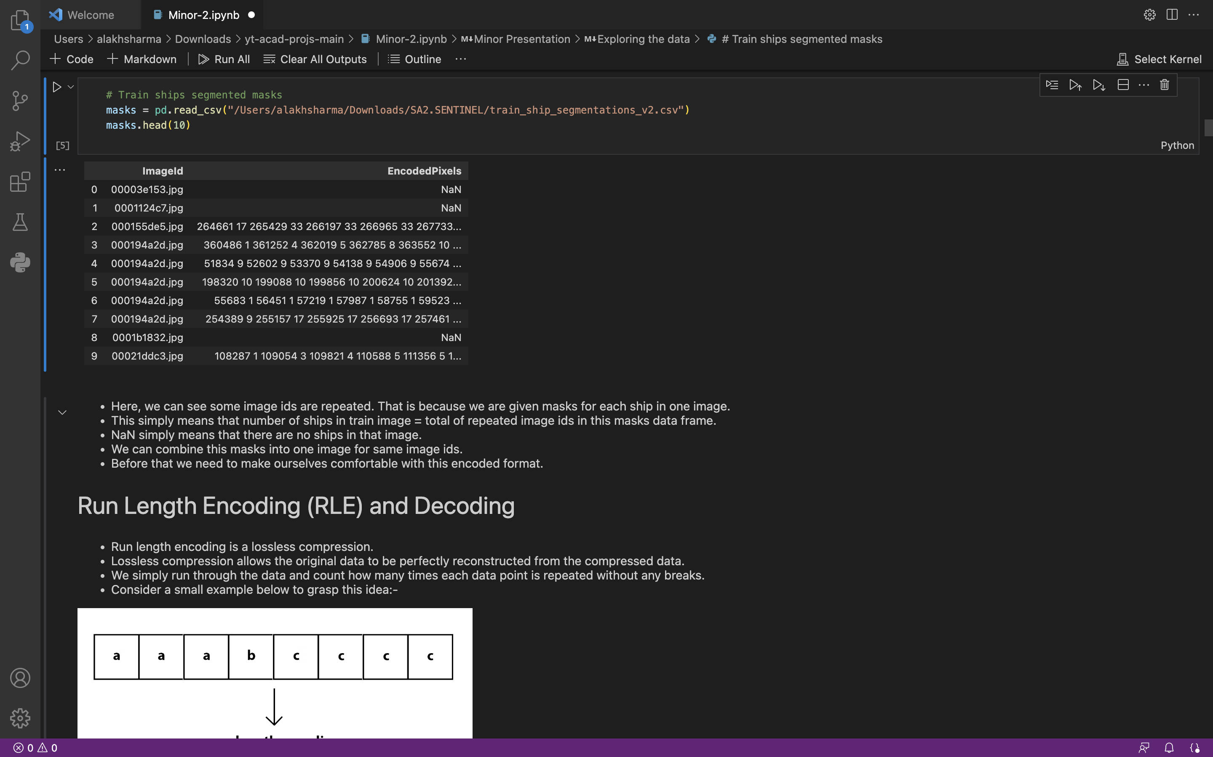
Working Model
Working Module
33

Slide 35
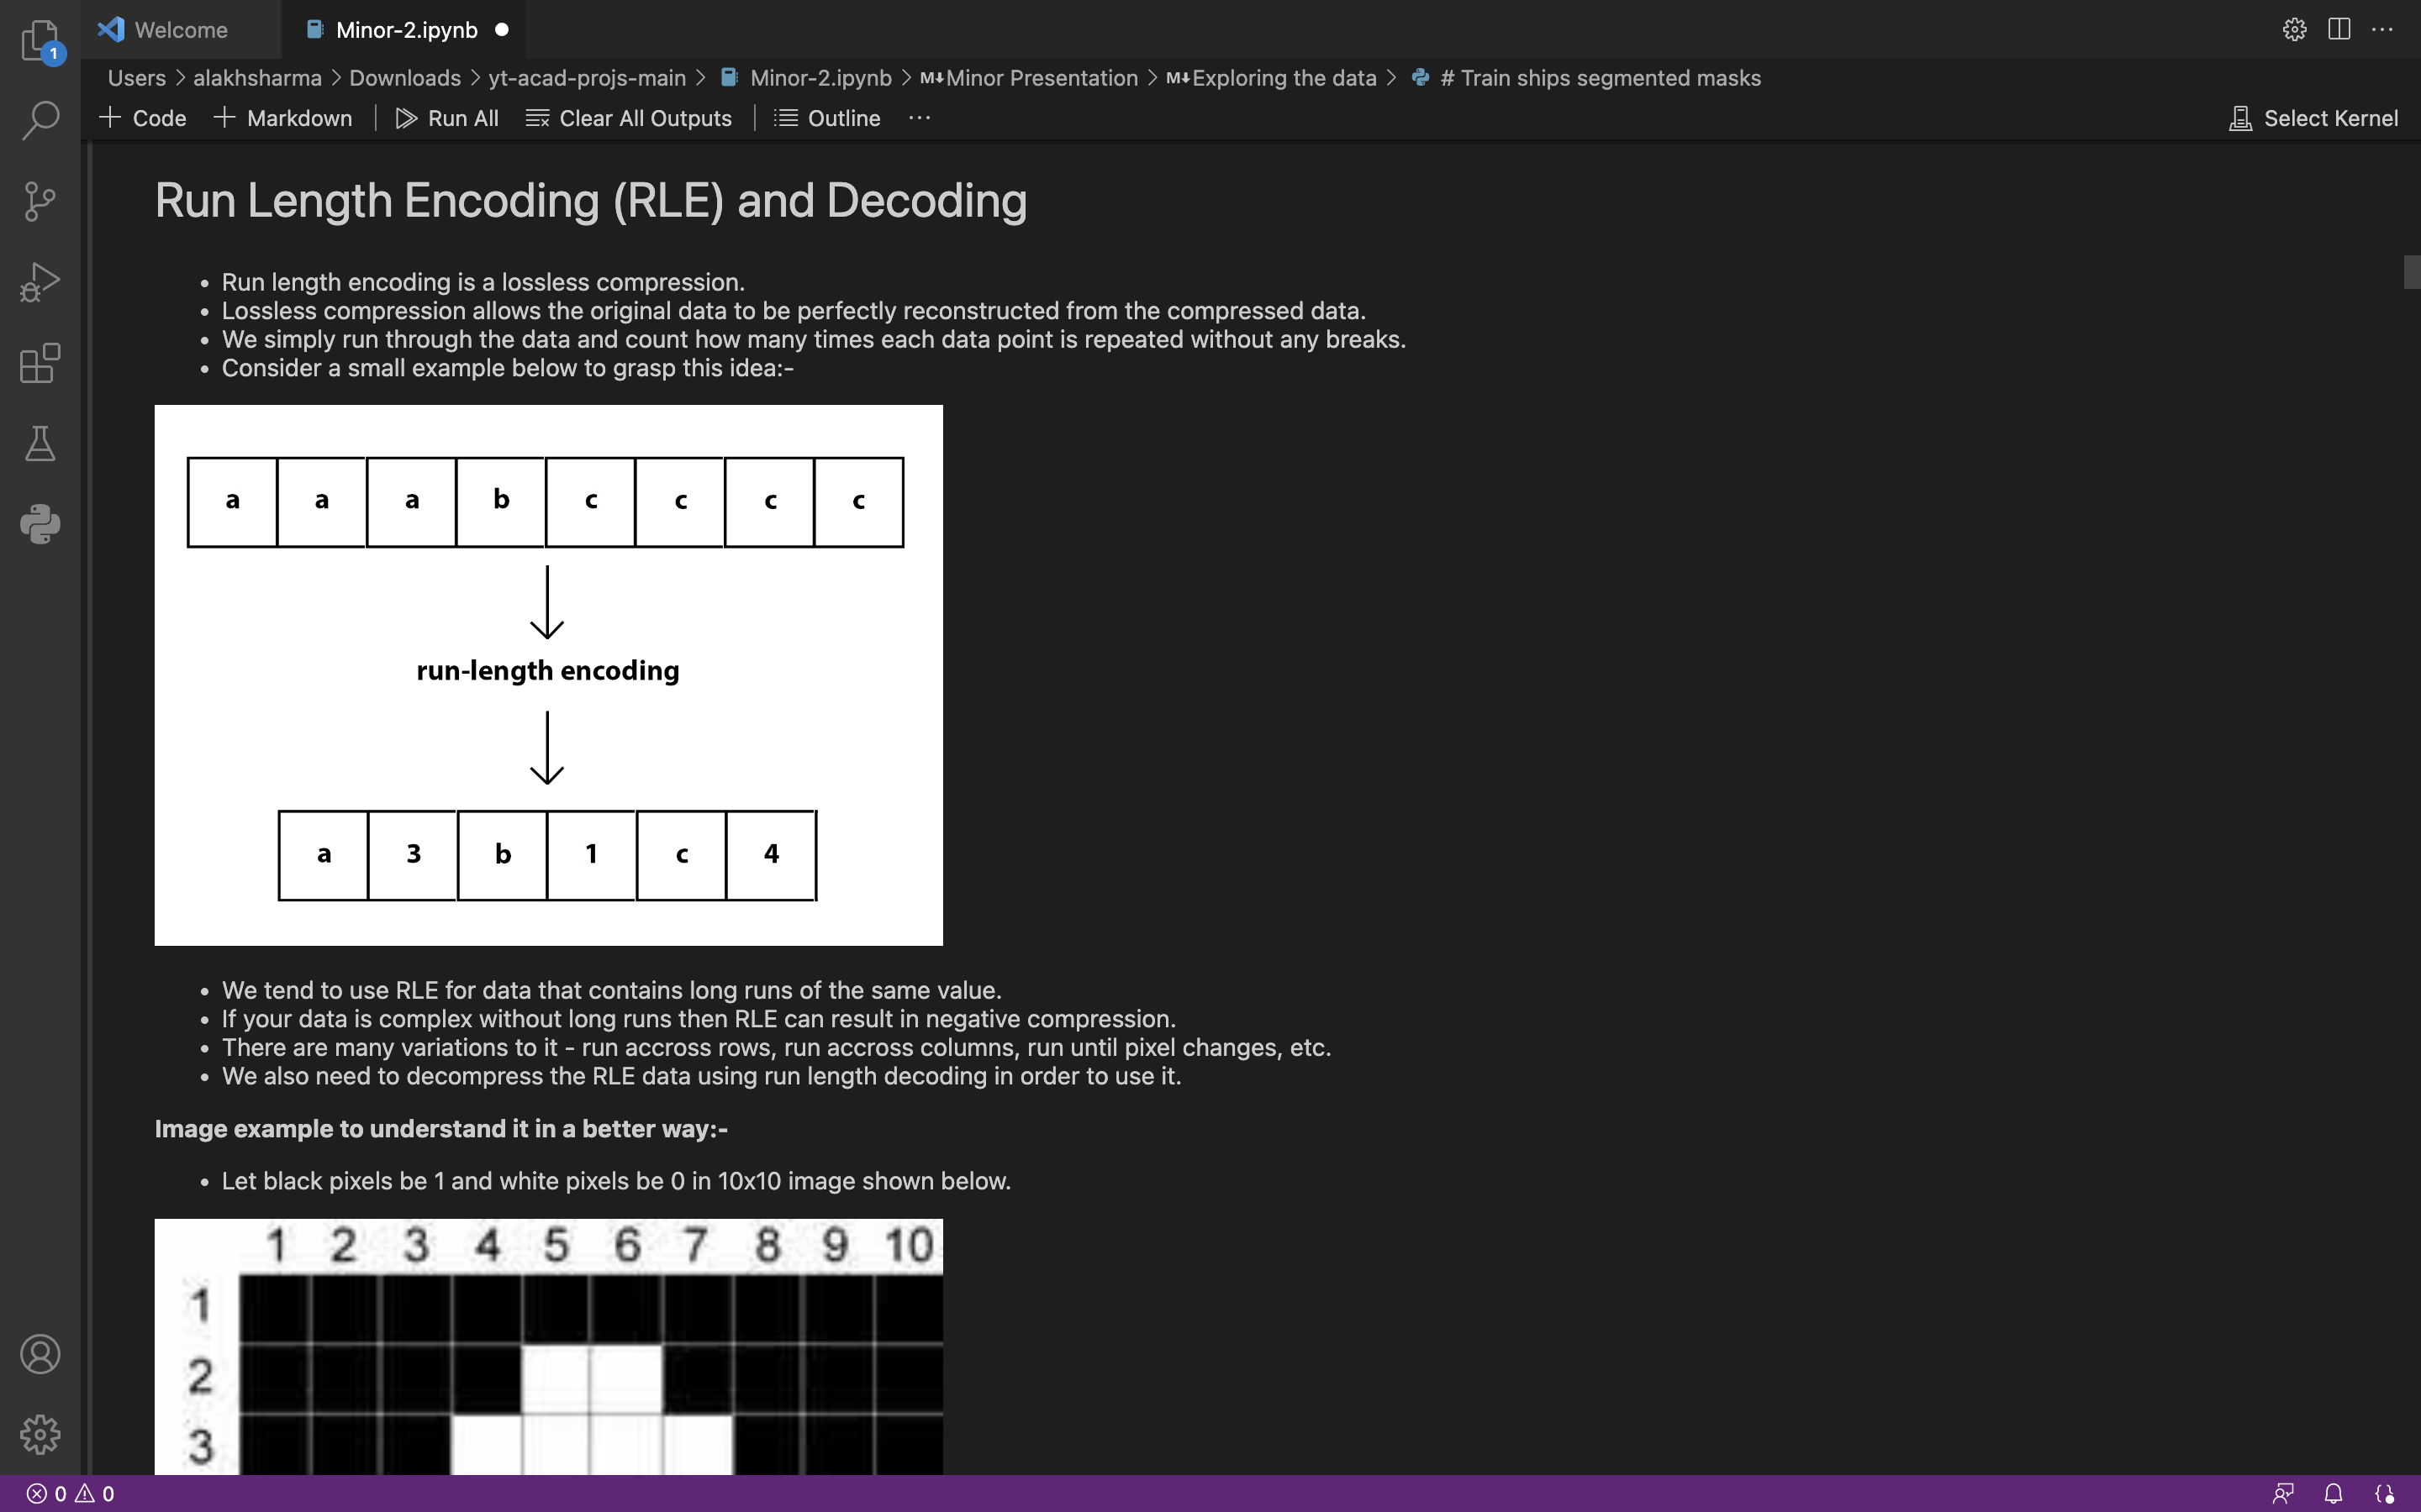
Working Model
Working Module
34

Slide 36
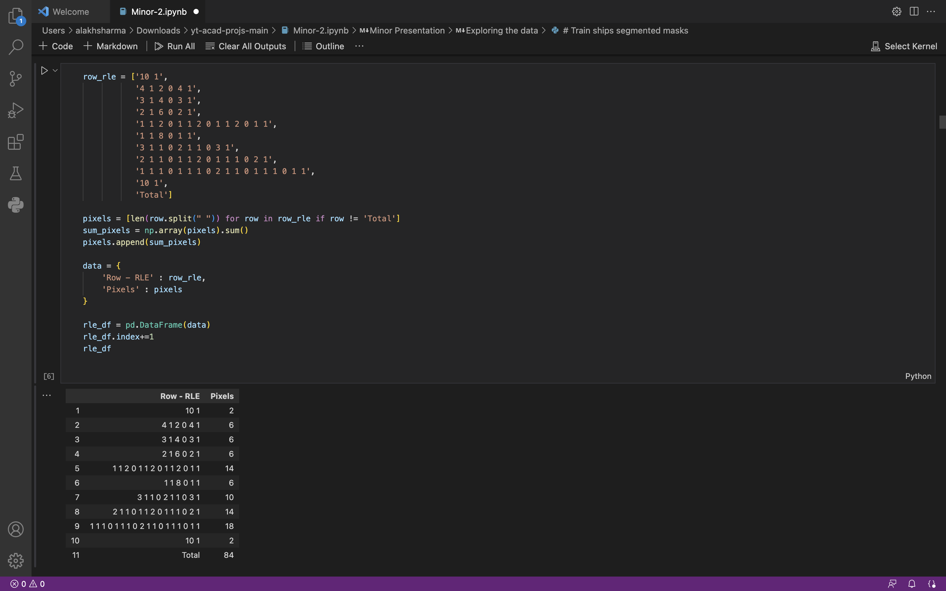
Working Model
Working Module
35

Slide 37
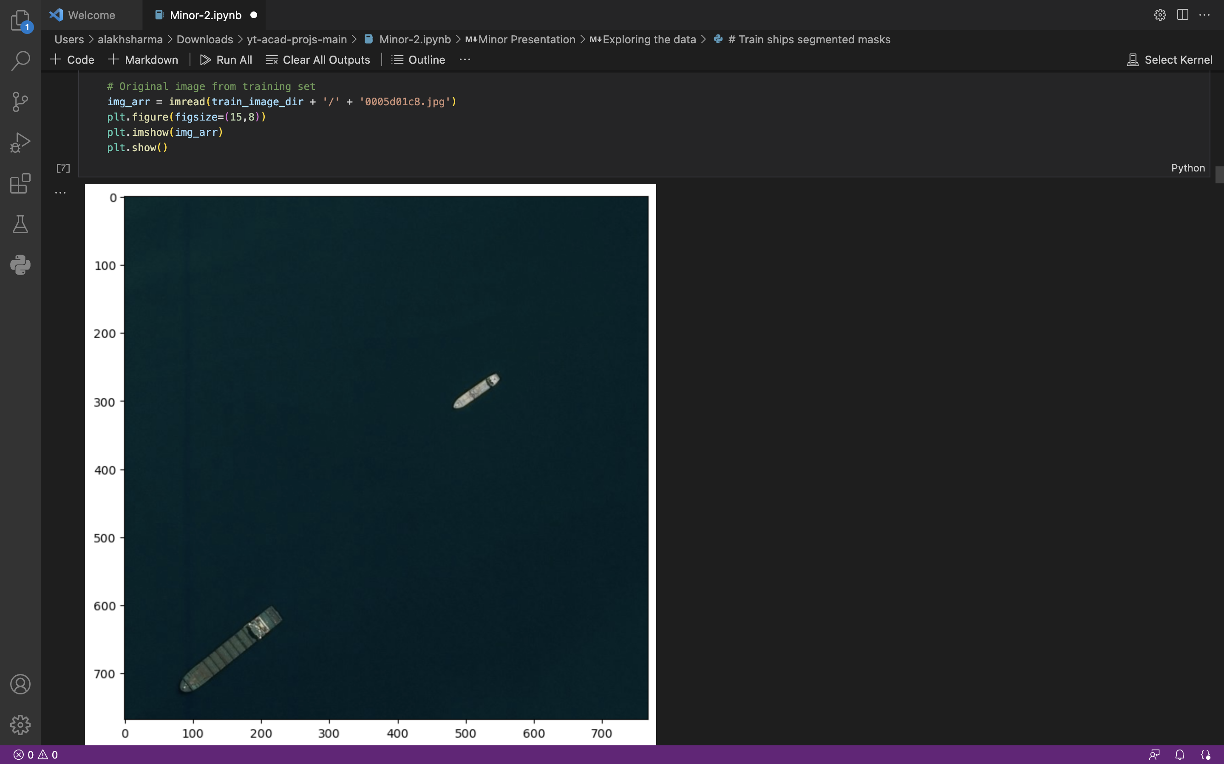
Working Model
Working Module
36

Slide 38
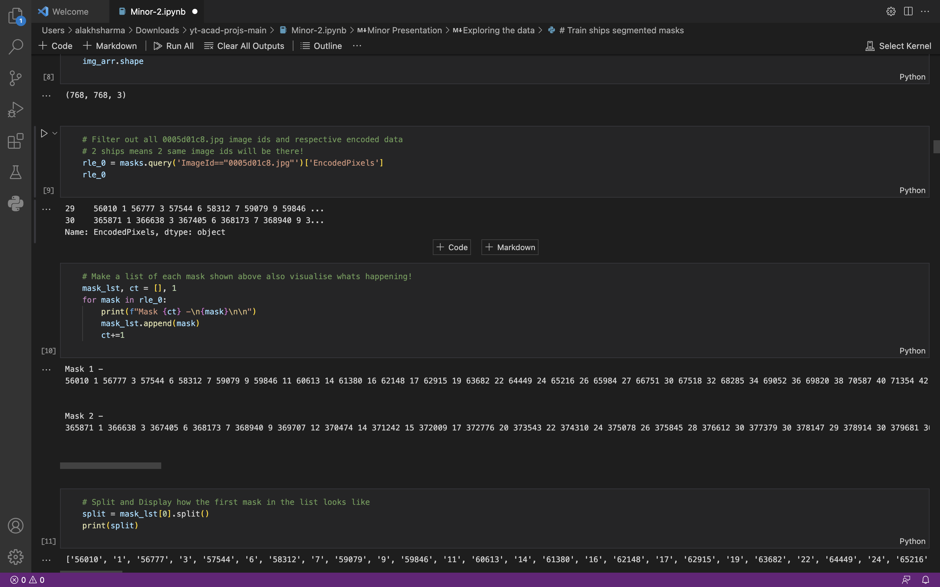
Working Model
Working Module
37

Slide 39
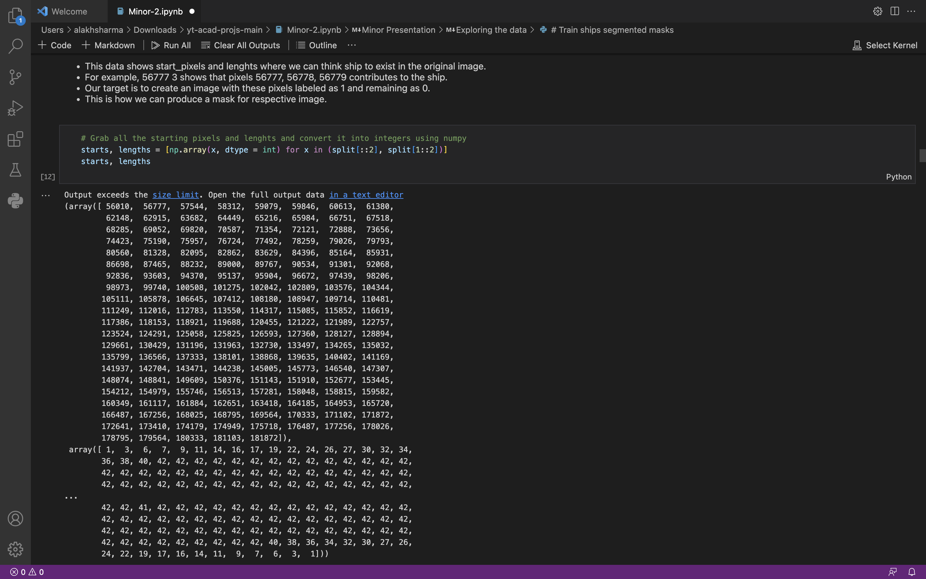
Working Model
Working Module
38

Slide 40
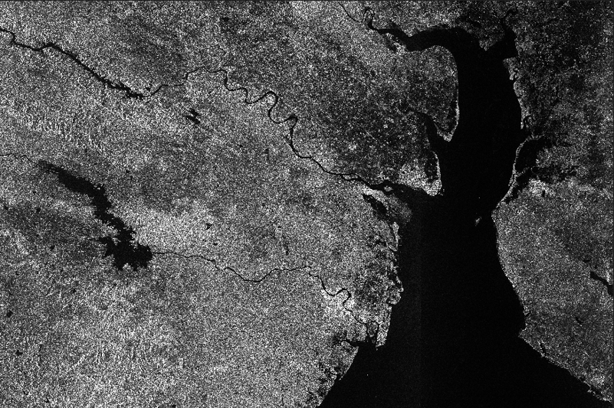
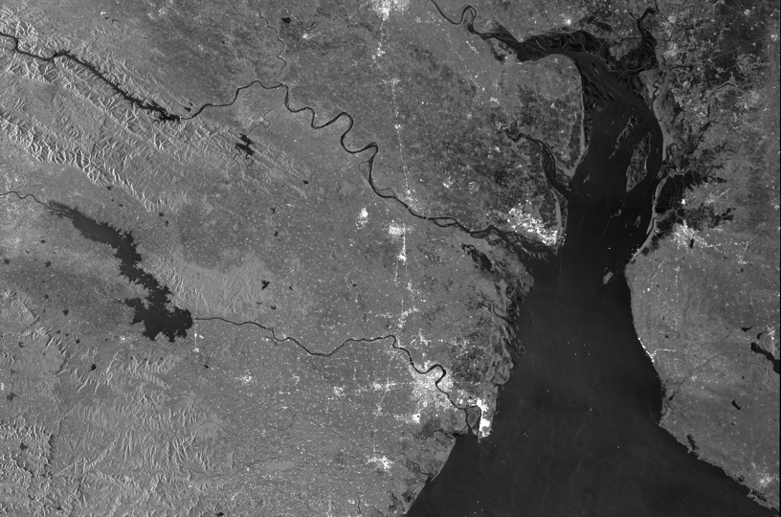
Working Model
Attained Deliverable
Fig No.11:Raw Data
Fig No.12: After Sentinel-2 Data preprocessing
39

Slide 41
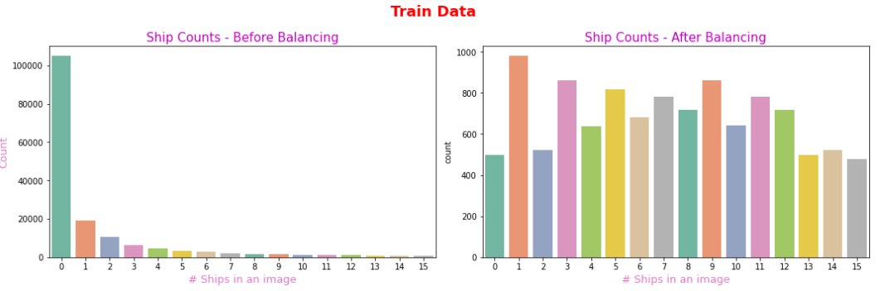
Working Model
Attained Deliverable
Fig No.13: Analysis of number of ships before and after balancing
40

Slide 42
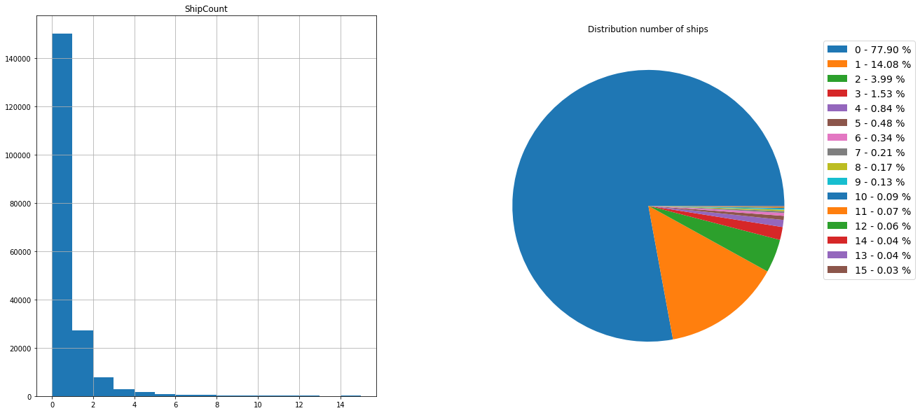
Working Model
Attained Deliverable
Fig No.14: Number of ships in dataset
41

Slide 43
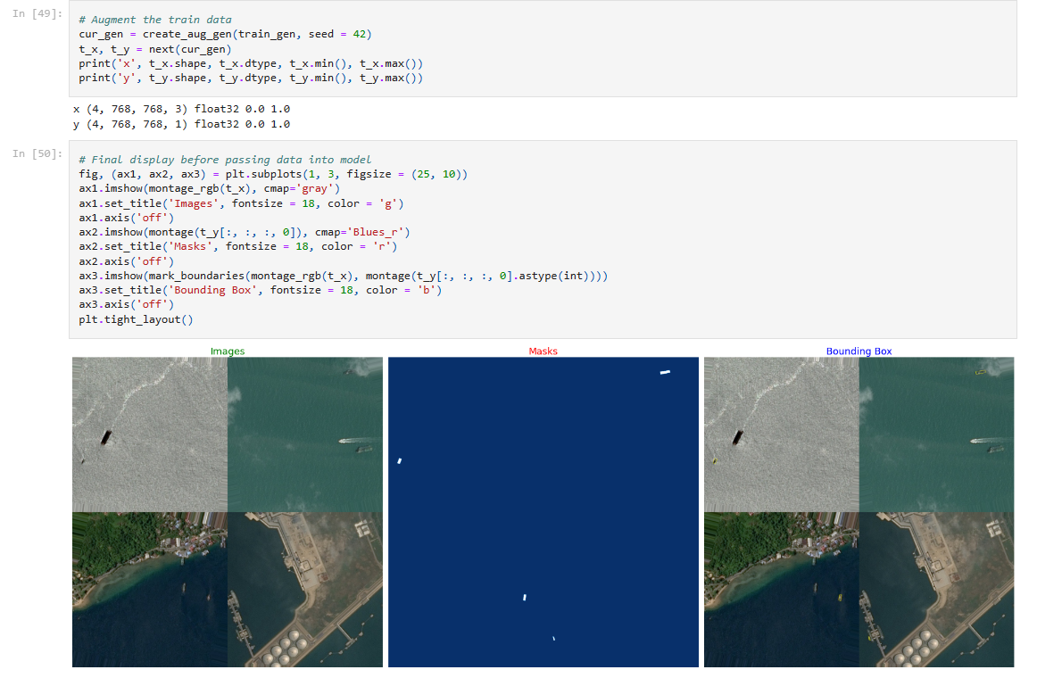
Working Model
Attained Deliverable
42

Slide 44
Reference
[1] Chong, J.; Zhu, M. Survey of the Study on Ship and Wake Detection in SAR Imagery. Acta Electron. Sin. 2003, 31, 1356–1360.
[2] Xi, Y.; Zhang, X.; Lai, Q.; Li, W.; Lang, H. A New PolSAR Ship Detection Metric Fused by Polarimetric Similarity and the Third Eigenvalue of the Coherency Matrix. In Proceedings of the IEEE International Geoscience and Remote Sensing Symposium, Beijing, China, 10–15 July 2016; pp. 112–115
[3] Yu, W.; Wang, Y.; Liu, H.; He, J. Superpixel-Based CFAR Target Detection for High-Resolution SAR Images. IEEE Geosci. Remote Sens. Lett. 2016, 13, 730–734.
[4] Fan, Q.; Chen, F.; Cheng, M.; Wang, C.; Li, J. A Modified Framework for Ship Detection from Compact Polarization SAR Image. In Proceedings of the IEEE International Geoscience and Remote Sensing Symposium, Valencia, Spain, 22–27 July 2018; pp. 3539–3542.
[5] Markopoulos, P.; Dhanaraj, M.; Savakis, A. Adaptive L1-Norm Principal-Component Analysis with Online Outlier Rejection. IEEE J. Sel. Top. Signal Process. 2018, 12, 1131–1143.
[6] Javed, S.; Mahmood, A.; Al-Maadeed, S.; Bouwmans, T.; Ki Jung, S. Moving Object Detection in Complex Scene Using Spatiotemporal Structured-Sparse RPCA. IEEE Trans. Image Process. 2018, 28, 1007–1022.
[7] Biondi, F. Low-Rank Plus Sparse Decomposition and Localized Radon Transform for Ship-Wake Detection in Synthetic Aperture Radar Images. IEEE Geosci. Remote Sens. Lett. 2018, 15, 117–121.
43

Slide 45
Reference
[8] Li, C.; Yu, Z.; Chen, J. Overview of Techniques for Improving High-resolution Spaceborne SAR Imaging and Image Quality. J. Radars 2019, 8, 717–731.
[9] Liu, T.; Yang, Z.; Yang, J.; Gao, G. CFAR Ship Detection Methods Using Compact Polarimetric SAR in a K-Wishart Distribution. IEEE J. Sel. Top. Appl. Earth Obs. Remote Sens. 2019, 12, 3737–3745.
[10] Li, J.; Tian, J.; Gao, P.; Li, L. Ship Detection and Fine-Grained Recognition in Large-Format Remote Sensing Images Based on Convolutional Neural Network. In Proceedings of the IEEE International Symposium on Geoscience and Remote Sensing (IGARSS), Waikoloa, HI, USA, 26 September–2 October 2020; pp. 2859–2862.
[11] Ai, J.; Cao, Z.; Xing, M. An Adaptive-trimming-depth Based CFAR Detector of Heterogeneous Environment in SAR Imagery. Remote Sens. Lett. 2020, 11, 730–738.
[12] Ai, J.; Cao, Z.; Mao, Y.; Wang, H.; Wang, F.; Jin, J. An Improved Bilateral CFAR Ship Detection Algorithm for SAR Image in Complex Environment. J. Radars 2021, 10, 499–515.
[13] Liu, T.; Yang, Z.; Jiang, Y.; Gao, G. Review of Ship Detection in Polarimetric Synthetic Aperture Imagery. J. Radars 2021, 10, 1–19.
[14] Zou, B.; Qiu, Y.; Zhang, L. Ship Detection Using PolSAR Images Based on Simulated Annealing by Fuzzy Matching. IEEE Geosci. Remote Sens. Lett. 2022, 19, 1–5.
44

Slide 46
Thank You

